Slide 1
.net Tutorial Part 04
ASP.net MVC

Slide 2
What is MVC
Model View Controller
Software Architectural Design Pattern
Separates application functionality
Promotes organized programming with the goal of making applications easier to maintain

Slide 3
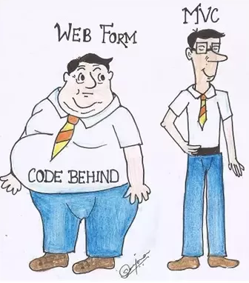
ASP.NET MVC
The state of a Web Form page is kept in a container known as ViewState, which can become quite large (not uncommon to see ViewStates pushing several megabytes in size).
In Internet scenarios, speed of transmission can affect everything from user satisfaction to search ranking.
The problem is compounded by the prevalence of mobile devices.
Bandwidth costs are of importance to many users on mobile platforms, and the time to load a large page over a cellular network can be enough to drive users away.

Slide 4
ASP.NET MVC
Separation of concerns (SoC) • From a technical standpoint, the organization of code within MVC is very clean, organized and granular, making it easier (hopefully) for a web application to scale in terms of functionality. Promotes great design from a development standpoint.
Easier integration with client side tools (rich user interface tools) • More than ever, web applications are increasingly becoming as rich as the applications you see on your desktops. With MVC, it gives you the ability to integrate with such toolkits (such as jQuery) with greater ease and more seamless than in Web Forms.
Search Engine Optimization (SEO) Friendly / Stateless • URL's are more friendly to search engines. Similarly, since MVC is stateless, this removes the headache of users who spawn multiple web browsers from the same window (session collisions). Along those same lines, MVC adheres to the stateless web protocol rather than 'battling' against it.

Slide 5
ASP.NET MVC
Works well with developers who need high degree of control • Many controls in ASP.NET web forms automatically generate much of the raw HTML you see when an page is rendered. This can cause headaches for developers. With MVC, it lends itself better towards having complete control with what is rendered and there are no surprises. Even more important, is that the HTML forms typically are much smaller than the Web forms which can equate to a performance boost - something to seriously consider.
Test Driven Development (TDD) • With MVC, you can more easily create tests for the web side of things. An additional layer of testing will provide yet another layer of defense against unexpected behavior.

Slide 6
ASP.NET MVC
The teams inside Microsoft make a great effort to maintain backward compatibility with previous versions of a product. While ASP.NET MVC is superior in many ways to Web Forms, it was never intended as a replacement so much as a second way of building a web application.
Web Forms still have some advantages over ASP.NET MVC
You do not necessarily need to make a decision about which approach to take, because you can mix MVC and Web Forms together in a single project.

Slide 7
ASP.NET MVC
ASP.NET MVC is closer to the wire than Web Forms, stripping away many of the abstractions that made Web Forms both heavy weight and easy to work with.
ASP.NET MVC is built on top of the Model-View-Controller pattern, and encourages isolating UI concerns in a view, behavior concerns in a controller, and storage and communication concerns in a model.

Slide 8
ASP.NET MVC
When a request arrives at an ASP.NET MVC site, one of the first things it encounters is the routing table, which directs the request to a destination that might be a file or it might be a chunk of code in a controller.
It enables custom URLs that are handy for giving users hints as to what is on the page as well as for search engine optimization.
It is now trivial to make a URL like:
https://site.com/{CompanyName}/User/Add
instead of
https://site.com/User/Add?companyId=15

Slide 9
ASP.net MVC
A browser does not just request web pages, in MVC the browser interacts with the application.
is able to invoke methods of a controller class

Slide 10
The M in MVC: Models
Data and business logic
Interactions with database (SELECT, INSERT, UPDATE, DELETE)
Relational (e.g. mysql) or nosql
Doesn’t actually require a database, could even just interact with a JSON file
Communicates with controller

Slide 11
The V in MVC: Views
Presentation and UI
Usually consists of HTML/CSS
Communicates with the controller

Slide 12
The C in MVC: Controllers
Sort of a “middle man”
Link the views with the data
Handles user actions and control flow
Gets data from model
Passes data to view

Slide 13
A Look at MVC Request
User sends the request in form of URL.
UrlRoutingModule intercepts the request and starts parsing it.
The appropriate Controller and handler will be identified from the URL by looking at the RouteTable collection. Also any data coming along with the request is kept in RouteData.
The appropriate action in the identified controller will be executed.
This action will create the Model class based on data.
The action will then pass on this created model class to some view and tell the view to proceed.
The view will then execute and create the markup based on the logic and Model's data and then push the HTML back to the browser.

Slide 14
A Quick Look at Routing
The controller and action will be decided by the URL
Let’s look at how this is done.
In the App_Start folder, there is a RouteConfig.cs that contains a default entry in the RouteTable:
routes.MapRoute(
name: "Default",
url: "{controller}/{action}/{id}",
defaults: new { controller = "Home", action = "Index", id = UrlParameter.Optional }
);

Slide 15
A Quick Look at Routing
routes.MapRoute(
name: "Default",
url: "{controller}/{action}/{id}",
defaults: new { controller = "Home", action = "Index", id = UrlParameter.Optional }
);
The name of the route is Default
The second argument specifies the pattern of the URL that should lead to this route usage
i.e. any URL with pattern “SiteAddress/{controller}/{action}/{id}” will use this route
The final argument specifies that if this route will be used then a controller named Home and an action Index will be invoked.
id is optional, meaning it could be present or not.

Slide 16
A Quick Look at Routing
The following URLs will invoke the respective actions and controllers:
Url: www.siteaddress.com Controller: Home Action: Index
Url: www.siteaddress.com/Home Controller: Home Action: Index
Url: www.siteaddress.com/User/Create Controller: User Action: Create
Url: www.siteaddress.com/User/Delete/1 Controller: User Action: Delete Id: 1

Slide 17
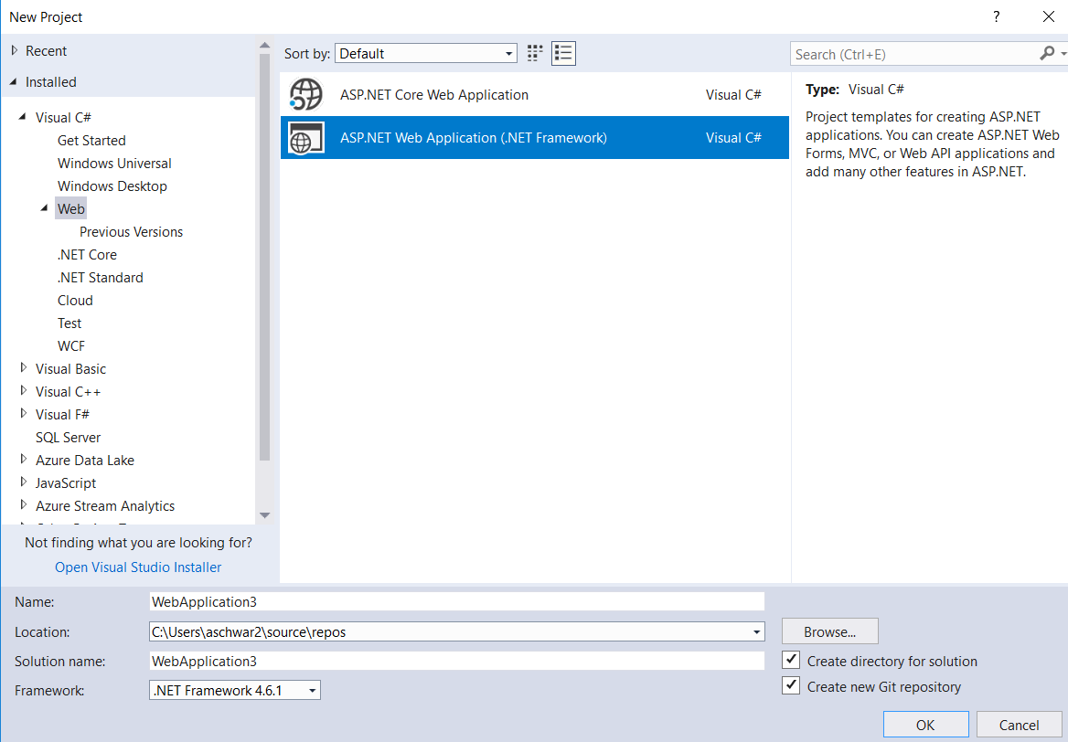
MVC Example – Creating Project
Choose File -> New -> Project
Expand Installed -> Visual C# ->
ASP.NET Web Application (.NET Framework)

Slide 18
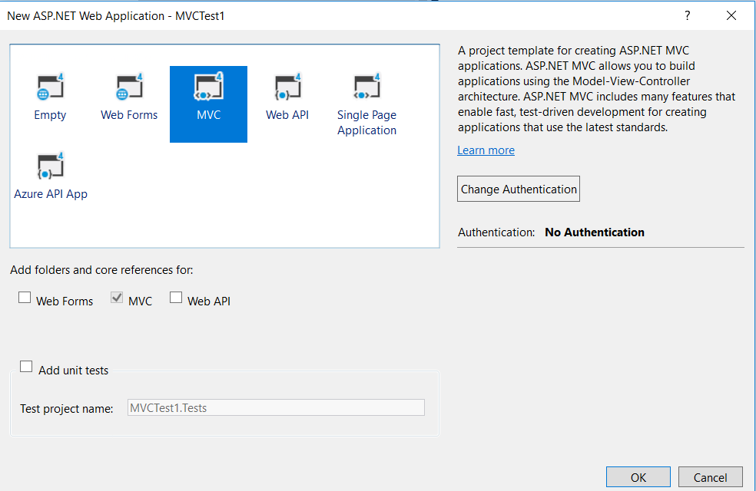
MVC Example – Creating Project
Name your project, click OK.
On the next screen
Choose MVC and click OK.

Slide 19
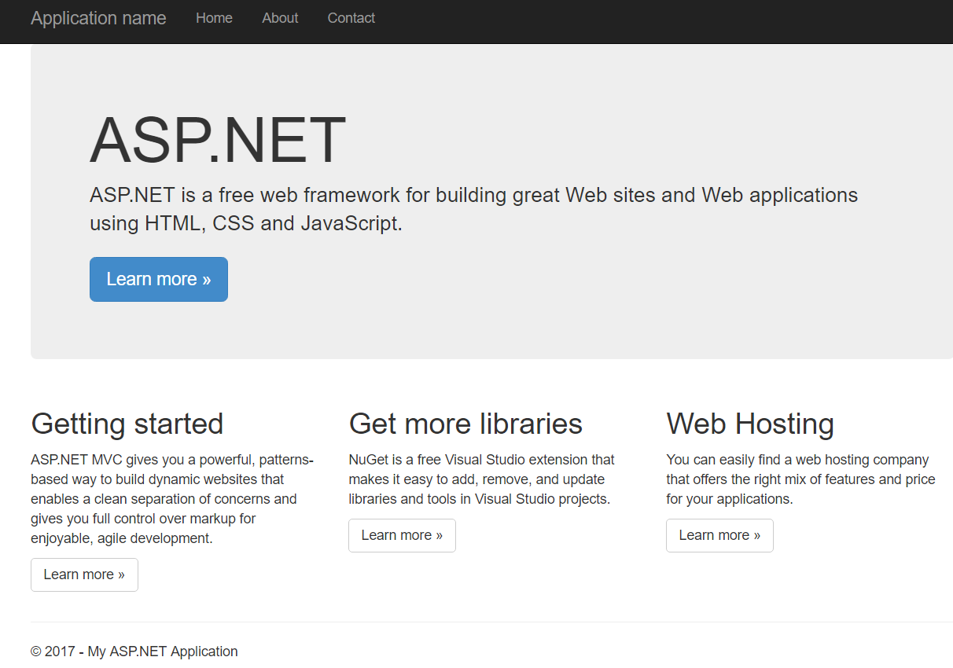
MVC Example – Running the Sample
From your new project, click F5 to run the sample project
Notice, there are actually resources to help learn MVC included in the template project.
If you click on “Learn More” there are a bunch of tutorials you can complete to learn MVC.

Slide 20
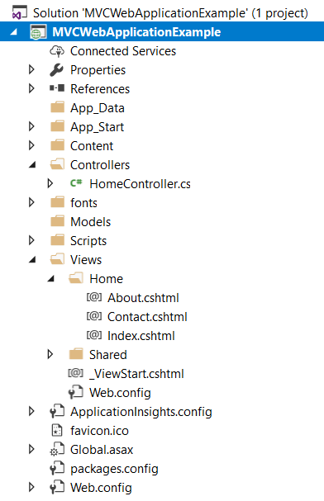
MVC Example – File Structure
Notice the Model, View, Controllers folders
Remember one of the advantages of MVC is giving you organization of your project right off the bat.
Notice how there is a Home controller, and then in Views there is a Home folder.
This folder is where any view the HomeController may use would be placed.
Run the project again and click on the About link. Notice the URL is /Home/About
That is using the About View from the /View/Home/About folder.

Slide 21
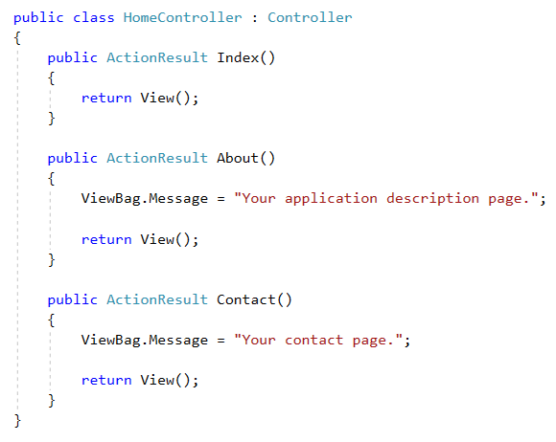
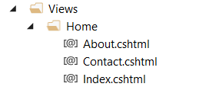
MVC Example – File Structure
Notice the methods in the Home controller:
Each method would interact with the corresponding view
Notice, it knows what view simply by the name

Slide 22
MVC Example – Creating a Controller
Right-click on the Controllers folder and select Add -> Controller
Select MVC 5 Controller – Empty
Click Add
Name your controller TestController and click Add
Note: Keep the word Controller in the name.

Slide 23
MVC Example – Creating a Controller
Open your new controller
Notice there is a method called Index
Delete this method and add the following method instead:
public string Hello()
{
return “Hello, World!”;
}

Slide 24
MVC Example – Creating a Controller
Run your project by clicking F5, then add to the end of the URL “ControllerName/ActionName”
Similar to: localhost:57524/Test/Hello
Note: In this URL, I named my controller TestController
TestController is the name of the class, whereas Test is the controller name.
The Action was Hello
An action method is simply a public method inside controller which accepts user’s request and returns some response.
In the example above, action method “Hello” is returning a string response type

Slide 25
MVC Example – Creating A View
In your new controller class, delete the Hello method and add the following method
public ActionResult Index()
{
return View();
}
Note: this was how the class was originally created.

Slide 26
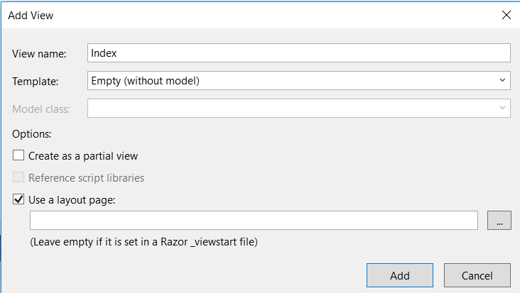
MVC Example – Creating A View
Right-click on the Index() method and click AddView
click Add.
A new View inside Views/Test folder should be created.

Slide 27
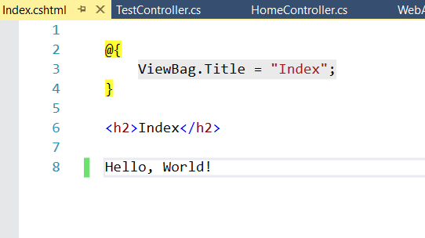
MVC Example – Creating a View
Open the new View and add some text after the <h2> tag
Click F5 and navigate to the appropriate URL

Slide 28
MVC Views – File Structure
The new view was placed in a Test folder in the Views folder because it was created from the method in the TestController
All the views related to the TestController will be placed inside “~/Views/Test” and Test controller can access only those views which are inside Test folder.
If you want to reuse a view across multiple controllers, they need to be placed in the Shared folder in Views.
Then they will be available to all controllers.

Slide 29
MVC Models
So far we’ve looked at how controllers can drive views, but the views have consisted of static data
This is not realistic to a “real” software application
We need to be able to access, manipulate, and display data
ENTER: MVC Models
What is a model?
Really, just a class

Slide 30
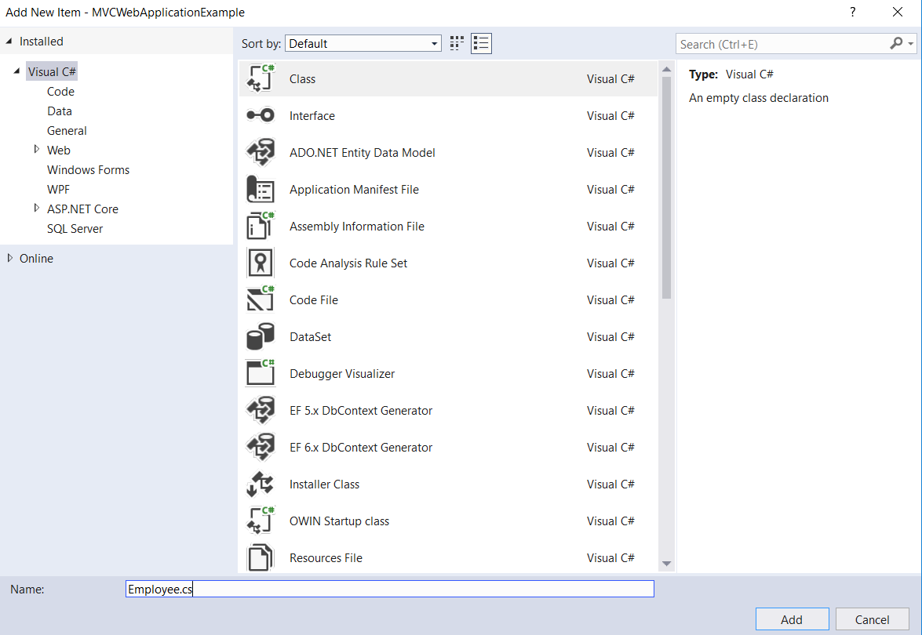
MVC Example – Creating A Model
Right-click on the Model folder and choose Add → Class
Name your class Employee and click Save.

Slide 31
MVC Example – Creating A Model
Create the Employee class:
public class Employee
{
public int EmployeeId { get; set; }
public string FirstName { get; set; }
public string LastName { get; set; }
[Required()]
public string Email { get; set; }
}

Slide 32
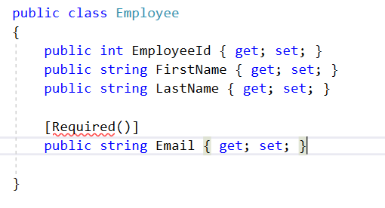
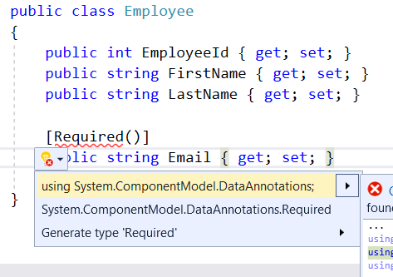
MVC Example – Creating a Model
Add the using statement to get rid of the syntax error.

Slide 33
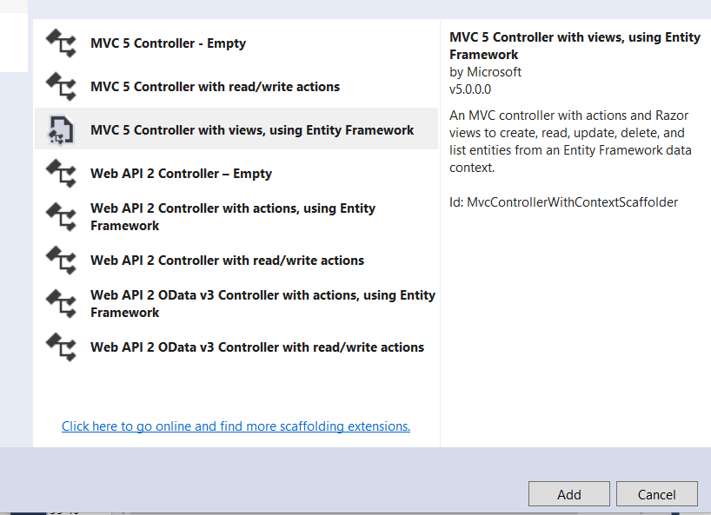
MVC Example – Creating A Model
After your model is created, you need something to be able to interact with that model.
Note: You must build the project before adding the controller
Right-click on Controllers and choose Add->Controller
Choose MVC 5 Controller with views, using Entity Framework
Choose Add

Slide 34
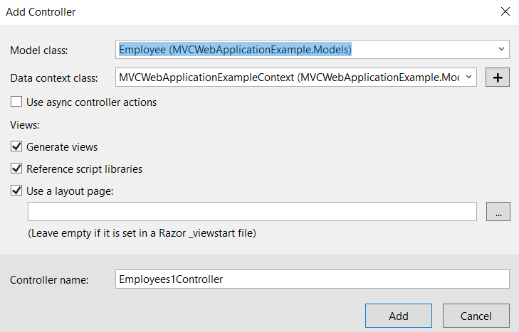
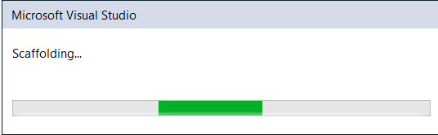
MVC Example – Creating A Controller and Views from a Model
Choose the Employee class for the Model class
Click the + next to Data Context to add a new Data Context
Accept default name and click Add
Note: later, we will learn to connect this to your database
Make sure all three text boxes are checked
Click Add on the Add Controller Dialog box

Slide 35
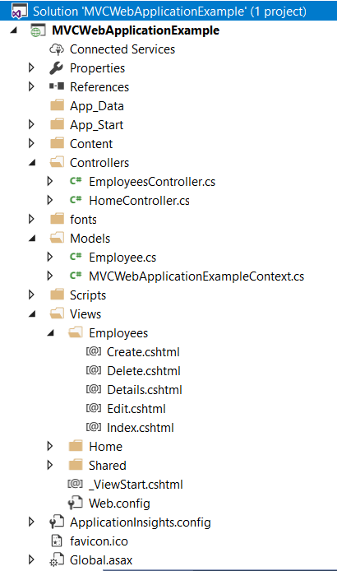
MVC Example – Creating A Controller and Views from a Model
Notice the new Employee controller
Also see the Views it created
Under Views/Employee we now have the following views:
Create
Delete
Details
Edit
Index

Slide 36
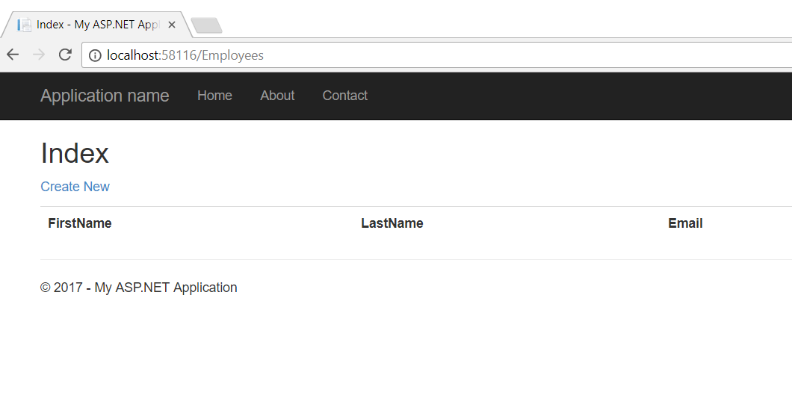
MVC Example – Auto-Generated Views
Run the project, and add /Employees to the URL
Click the Create New link on the page

Slide 37
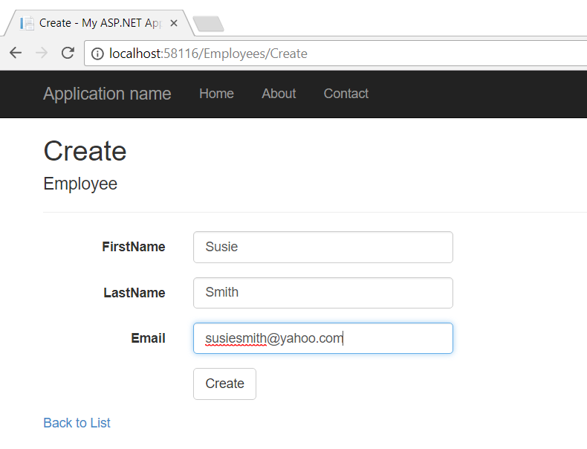
MVC Example - Auto-Generated Views
Enter some data and click Create.

Slide 38
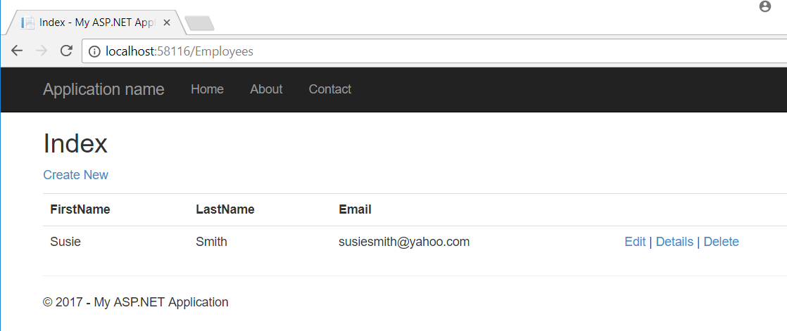
MVC Example – Auto-Generated Views
The record is added. Notice there is an Edit, Details, and Delete as well

Slide 39
MVC Example - Validation
Remember the [Required()] in the Email field?
Try to create an employee without entering an Email.

Slide 40
MVC Example – Auto- Generated Views
Close the application and reopen to the ~/Employees URL
Notice the data is still there!

Slide 41
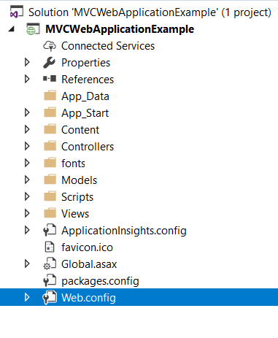
MVC Example – Voodoo magic?
That’s pretty neat, but where the heck is that data going?
It is going in a database that was created for you through the scaffolding process
And where is this database?
First, it is important to know about an essential file in all .net web applications, the web.config.
The web.config stores important configuration information for a website, such as the database connection string (how to connect to the database for the application)

Slide 42
MVC Example – Web.config
In the Web.config, you will see the following entry:
<connectionStrings>
<add name="MVCWebApplicationExampleContext" connectionString="Data Source=(localdb)\MSSQLLocalDB; Initial Catalog=MVCWebApplicationExampleContext-20170912131333; Integrated Security=True; MultipleActiveResultSets=True; AttachDbFilename=|DataDirectory|MVCWebApplicationExampleContext-20170912131333.mdf"
providerName="System.Data.SqlClient" />
</connectionStrings>
This entry tells the application where to find the database.

Slide 43
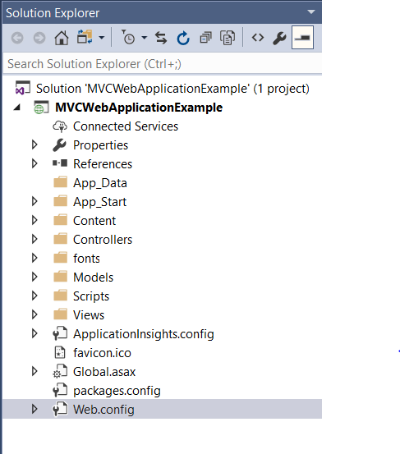
MVC Example – dude, where’s my data?
Let’s try to locate this file
The folder App_Data seems like a good place to start
Wait, it’s empty?
Not really, the application just doesn’t show it by default
You need to click “Show all files” in Solution Explorer

Slide 44
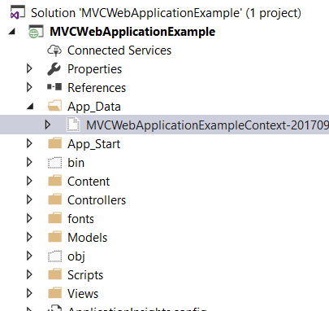
MVC Example – dude, where’s my data?
Now expand App_Data
There’s your database

Slide 45
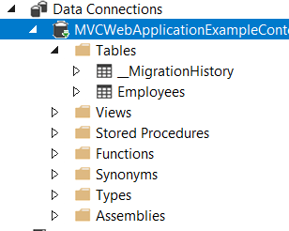
MVC Example – dude, where’s my data?
If you double-click on the file, you can view the tables, etc.
We will spend a lot more time talking about databases and proper database structure in future classes

Slide 46
MVC Example – Customizing a View
You can easily customize how the fields are labeled on a view by making a simple modification to the model class.
For example, you can change FirstName to First Name by the following code:
[Display(Name="First Name")]
Run your project and notice that change is reflective on all the views, Home, Create, Edit, Details, and Delete.

Slide 47
Database-First MVC
Create the Model from the Database like shown previously
Right-click on the Models folder
Choose Add -> New Item → ADO.net Entity Data Model
Follow the wizard (as shown in previous slides)
Add a Controller
In the Data Context Class, choose the model created in previous step

